Slide 1
Content AND Location-Aware P2P-CDN Architecture with Integrated Round trip Time and available bandwidth-Based Peer Selection Protocol
Team Chupacabra {De Villa, Ongcol, Tan}

Slide 2
Definition of Terms
Content Distribution Network (CDN)
Dedicated servers in assigned areas
Reliable but expensive
Peer-to-Peer Network (P2P)
Utilizes bandwidth of peers
Scalable
Round Trip Time(RTT)
Time it takes to make a request and receive a response
Available Bandwidth (ABW)
Remaining capacity for data that can travel between the link that connects nodes in a network

Slide 3
Background of the Study
P2P-CDN Hybrid Architectures
Traditional^{[2]}
G-CP2P^{[1]} (Content and Location Aware)
Peer Selection Schemes
Random
RTT-based (Round Trip Time)
ABW-based (Available Bandwidth)
AEPS (Adaptive and Efficient Peer Selection)^{[3]}
[1] T. Kim, S. Jeon, and Y. Kim, “A CDN-P2P Hybrid Architecture with Content/Location Awareness for Live Streaming Service Networks,” 2011 IEEE 15th International Symposium on Consumer Electronics, 2011.
[2] D. Xu, S. Kulkarni, C. Rosenberg, and H. Chai, “Analysis of a CDN-P2P hybrid architecture for cost-effective streaming media distribution,” Springer Multimedia Systems, vol. 11, no. 4, pp. 383-399, 2006
[3] T. Hsiao, M. Hsu, and M. Yiao, “Adaptive and Efficient Peer Selection in Peer-to-Peer Streaming Networks,” 2011 IEEE 17th International Conference on Parallel and Distributed Systems, 2011.

Slide 4
P2P-CDN Hybrid Architectures
A CDN-P2P Hybrid Architecture with Content/Location Awareness for Live Streaming Service Networks
Analysis of a CDN-P2P Hybrid Architecture for Cost-effective Streaming Media Distribution

Slide 5
Traditional CDN-P2P
{Xu, Kulkarni, Rosenberg, Chai}
Media content to be distributed
M
CDN Server
P
P
CDN Server
P
P
P
P
P
P
P
P
P
Clients
Notes:
elements involved in traditional cdn-p2p architecture

Slide 6

Traditional CDN-P2P
{Xu, Kulkarni, Rosenberg, Chai}
Store media into the CDN Server for distribution
M
CDN Server
P
P
P
P
P
P
P
P
P
P
P

Slide 7
Traditional CDN-P2P
{Xu, Kulkarni, Rosenberg, Chai}
CDN Server streams the media to the requesting clients.
CDN Server
P
P
M
P
P
P
P
P
P
P
P
P

Slide 8
Traditional CDN-P2P
{Xu, Kulkarni, Rosenberg, Chai}
CDN Server creates Supplying Peers
CDN Server
P
P
M
P
P
P
P
P
P
P
P
P

Slide 9
Traditional CDN-P2P
{Xu, Kulkarni, Rosenberg, Chai}
CDN-to-P2P Handoff
CDN Server
P
P
M
P
P
P
P
P
P
P
P
P
Notes:
Media file is distributed to the Supplying Peers and removed from the CDN server to save space. This event is called the CDN to P2P handoff

Slide 10
Traditional CDN-P2P
{Xu, Kulkarni, Rosenberg, Chai}
New clients will stream the content through the Supplying Peers
CDN Server
P
P
P
P
P
P
P
P
P
P
P

Slide 11
Traditional CDN-P2P
{Xu, Kulkarni, Rosenberg, Chai}
In the event of a new Requesting Peer, it first asks the CDN server for a list of candidate Supplying Peers
P
CDN Server
P
P
P
P
P
P
P
P
P
P
P

Slide 12
Traditional CDN-P2P
{Xu, Kulkarni, Rosenberg, Chai}
If no Supplying Peer accepts its request, it will connect directly to the CDN server.
P
CDN Server
P
P
P
P
P
P
P
P
P
P
P

Slide 13
Traditional CDN-P2P
{Xu, Kulkarni, Rosenberg, Chai}
Cost-effective
Higher connection set-up time and packet delivery latency
Notes:
cost-effective: since media distribution is not solely dependent on CDN since P2P is also involved
random peer selection: compromises efficiency leading to higher connection set-up time and latency

Slide 14
G-CP2P
{Kim, Jeon, Kim}
SuperPeer
Physically close to the CDN server
Stores the following information:
Peer ID
Channel Information
Peer Status
Provides content for streaming

Slide 15
G-CP2P
{Kim, Jeon, Kim}
Overlay Network for SuperPeers
Binning Technique
New peer measures RTT per area
Areas are arranged according to increasing latency
Peers are ‘binned’ together based on the RTT

Slide 16
G-CP2P
{Kim, Jeon, Kim}
Sub-overlay
Consists of peers that stream the same content and are in the same location
Managed by a SuperPeer

Slide 17
G-CP2P
{Kim, Jeon, Kim}
SuperPeer Overlay Network
SuperPeer
Sub-overlay
SP
SP
New Peer
Landmarks
L
L
SP
P
L
SP
SP
Notes:
the elements of a gcp2p architecture are

Slide 18
G-CP2P
{Kim, Jeon, Kim}
Measure RTT for each landmark.
Arrange according to RTT values
SP
SP
L
L
SP
P
L
SP
SP

Slide 19
G-CP2P
{Kim, Jeon, Kim}
New Peer chooses the bin it belongs to
SP
SP
L
L
SP
P
L
SP
SP

Slide 20

G-CP2P
{Kim, Jeon, Kim}
New Peer queries SuperPeer of
bin for a Channel A
SP
SP
L
L
SP
P
L
SP
SP

Slide 21
G-CP2P
{Kim, Jeon, Kim}
If SuperPeer does not stream a
Channel A,
then the SuperPeer
asks the other SuperPeers
SP
SP
L
L
SP
P
L
SP
SP

Slide 22
G-CP2P
{Kim, Jeon, Kim}
The SuperPeer with the
most number of peers is
selected and from
there the New Peer will
connect to the sub-overlay
of the newly chosen
SuperPeer
SP
SP
L
L
SP
P
L
SP
SP
Notes:
new peer continues to search for the channel and will only stop it has found the sub-overlay or when it has tried everything but failed

Slide 23
Peer Selection Schemes
Random-based
RTT-based
ABW-based
Adaptive and Efficient Peer Selection in Peer-to-Peer Streaming Network
Notes:
the next main idea is on peer selection two of the schemes relevant to the research are random-based and rtt-based

Slide 24
Random
Random
Randomly select from a list of candidate peers
High-quality streaming is not guaranteed
Simplest and most efficient
Least accurate
Notes:
basically randomly selects a peer to connect to from a given list since it is random, peer selection is fast and simple but since the selection has no basis, the quality and accuracy of the stream is not guaranteed

Slide 25
RTT
Round Trip Time
Uses a single message to measure RTT of each peer in candidate list
Small RTT value is ideal
Selects candidates that are geographically close to requesting client
More accurate than random-based schemes
Notes:
rtt-based peer selection schemes uses round trip time information which is measured using a single message this scheme has a tendency to select candidate that are physically close to the requesting client thus making it more accurate than random-based peer selection schemes

Slide 26
ABW
Available Bandwidth
Estimates ABW between requesting peer and candidate peer
Large ABW is ideal
More accurate than RTT-based schemes
Notes:
PRM – Candidate peer sends probing packets to requesting peer with different transmitting rates
PGM – Candidate peer injects a series of packets with different gaps

Slide 27
AEPS
{Hsiao, Hsu, Yiao}
Adaptive and Efficient Peer Selection
RTT
ABW
AEPS
Efficiency
Accuracy

Slide 28
The Problem
G-CP2P utilizes only RTT information in CDN assignment and binning. AEPS has pointed out that RTT alone is insufficient since it may select a peer who will not be able to provide high quality streaming. ABW resolves this issue by indicating the remaining capacity between the bandwidth of two nodes.
On the other hand, AEPS does not incorporate content and location-aware peer selection. Assignment to the wrong CDN and uncategorized video content lead to high connection set-up time and high playback delay.

Slide 29
AEPS
{Hsiao, Hsu, Yiao}
Index Server
Requesting Peer
Tracker
R
Streaming Server
Streaming Server
C
Candidate Servers
C
C
C
C
C
C

Slide 30
AEPS
{Hsiao, Hsu, Yiao}
Stage 1: Demand
Request for a list of Candidate Peers
Index Server
R
Streaming Server
C
C
C
C
C
C
C

Slide 31
AEPS
{Hsiao, Hsu, Yiao}
Stage 2: Query & Rank
Order Candidate Peers according to their RTT values
Index Server
R
Streaming Server
C
C
C
C
C
C
C

Slide 32
AEPS
{Hsiao, Hsu, Yiao}
Stage 3: Verify
Confirm that
bandwidth requirement
is supported
Index Server
R
Streaming Server
C
C
C
C
C
C
C

Slide 33
Propose
G-CP2P
(Content/Location
Aware)
RTT + ABW Peer Selection
Proposal
Efficiency +
Reduced Network
Disruption Time
Efficiency +
Accuracy
Notes:
so the idea is essentially integrating the two ideas – gcp2p architecture and rtt-based peer selection - to create a protocol that has the advantages of both

Slide 34
Thesis Statement
We propose to design a content and location-aware P2P-CDN architecture that employs an RTT and ABW-based peer selection scheme to provide users with an efficient and high quality video streaming experience for stored content.

Slide 35
Scope and Limitations of the Study
Our protocol adapted the G-CP2P scheme but applied it to a different context.
The original G-CP2P was done for live streaming of videos while we did ours for stored content.
Instead of channels, videos are classified into categories.

Slide 36
The Orange Structure

Slide 37
The Network

Slide 38
CDN Server

Slide 39
Landmarks
L1
L2
L3

Slide 40
L1
L2
L3

Slide 41
Bins
B2
B1
B3
B6
B4
B5
Notes:
bins are permutations of the landmarks defined on a network

Slide 42
SuperPeers

Slide 43
Content
Sub-overlays

Slide 45
Regular Nodes
P1
P5
P2
P4
P3
Connected to their SuperPeer

Slide 46
A Network of Oranges

Slide 47
The Orange Protocol

Slide 48
There are three CDN servers
in the network:
{CDN₁, CDN₂, CDN₃}
1
3
2

Slide 49
Let NP be the new peer who
wishes to stream a video: vid_1
1
NP_{vid_1}
3
2

Slide 50
NP first measures its RTT on each
of the three CDN servers.
1
NP_{vid_1}
3
2

Slide 51
Let its RTT to
CDN₁= 75 ms
1
NP_{vid_1}
3
2
Notes:
Nearest 30-100 ms
Others 1k – 1.5k ms

Slide 52
Let its RTT to
CDN₂= 750 ms
1
NP_{vid_1}
3
2
Notes:
Nearest 30-100 ms
Others 1k – 1.5k ms

Slide 53
Let its RTT to
CDN₃= 150 ms
1
NP_{vid_1}
3
2
Notes:
Nearest 30-100 ms
Others 1k – 1.5k ms

Slide 54
NP chooses the CDN server with
The least RTT value. In this case,
It is CDN₁
1
NP_{vid_1}
CDN Server | RTT
CDN₁ | 75 ms
CDN₂ | 750 ms
CDN₃ | 150 ms
3
2
Notes:
Nearest 30-100 ms
Others 1k – 1.5k ms

Slide 55
CDN₁ has 3 predefined landmarks: {L1, L2, L3}
L3>L1>L2
L2
L3>L2>L1
L1>L3>L2
L1
L3>L2>L1
L2>L3>L1
L3
L2>L1>L3

Slide 56
NP will measure its RTT on each landmark then arrange
them by increasing value
L3>L1>L2
L2
L3>L2>L1
L1>L3>L2
L1
L3>L2>L1
L2>L3>L1
L3
L2>L1>L3
Landmark | RTT
L1 | 30
L2 | 50
L3 | 65

Slide 57
Since L3>L2>L1, NP will go
to ‘bin’ itself in that
location
L3>L1>L2
L2
L3>L2>L1
L1>L3>L2
L1
L3>L2>L1
L2>L3>L1
L3
L2>L1>L3
Landmark | RTT
L1 | 30
L2 | 50
L3 | 65

Slide 58




Suppose that the bin’s SuperPeer has 3 sub-overlays: S1, S2, S3 and S3 has vid_1 then NP establishes a connection there.
S2
S1
S3
SP

Slide 59
Inside S3 there are peers streaming vid_1.
P1
P5
P2
P4
P3

Slide 60
NP will arrange the nodes by RTT and choose only nodes that can support its bandwidth by computing for ABW.
P1
P5
P2
P4
P3

Slide 61
Suppose that the bin’s SuperPeer has 3 sub-overlays: S1, S2, S3 and none of them stream vid_1.
S2
S1
S3
SP

Slide 62
The SuperPeer in that bin will ask the other SuperPeers if they have vid_1.
Notes:
superpeer with the most number of peers is returned and from that list, the new peer chooses which peer to connect to.

Slide 63
If vid_1 is still not found, NP will connect to the CDN.
S2
S1
S3
SP
CDN

Slide 65
Proposed Structure “Caviar Structure”
CDN Server
SP
SuperPeers
Sub-overlays
CDN Server
SP
SP
SP

Slide 66
Proposed Structure “Caviar Structure”
SP
Peers watching the same
content
CDN Server
SP
SP
SP

Slide 67
Proposed Structure “Caviar Structure”
Peers watching the same
content
SP

Slide 68
Proposed Structure “Caviar Structure”
Peer | RTT | ABW
2 | 30 ms | Y
4 | 55 ms | Y
3 | 94 ms | N
5 | 102 ms | Y
P2
P1
P5
P3
Rank peers according to RTT and
verify bandwidth support. From the
list, choose the peers.
P4

Slide 69
Baselines and their Results
Traditional P2P-CDN
G-CP2P with RTT Peer Selection

Slide 70
Settings
3 CDNs
Network Size: max 10,000 nodes
Upload Speed Range: 0 – 1,000 kbps
Download Speed Range: 1,000 – 2,000 kbps
RTT Values: 30 – 70 ms
Number of video categories: 6 categories
Number of videos per category: 20 videos

Slide 71
Metrics (Average of Nodes/Step)
Connection Set-up Time – time elapsed since a node first requested for a peer to connect to until a connection was established
First Playback Delay – time elapsed since a connection was established until the time the required amount of packets was received
Utilization Rate
= (Used Download Speed)/(Download Speed)*100

Slide 72
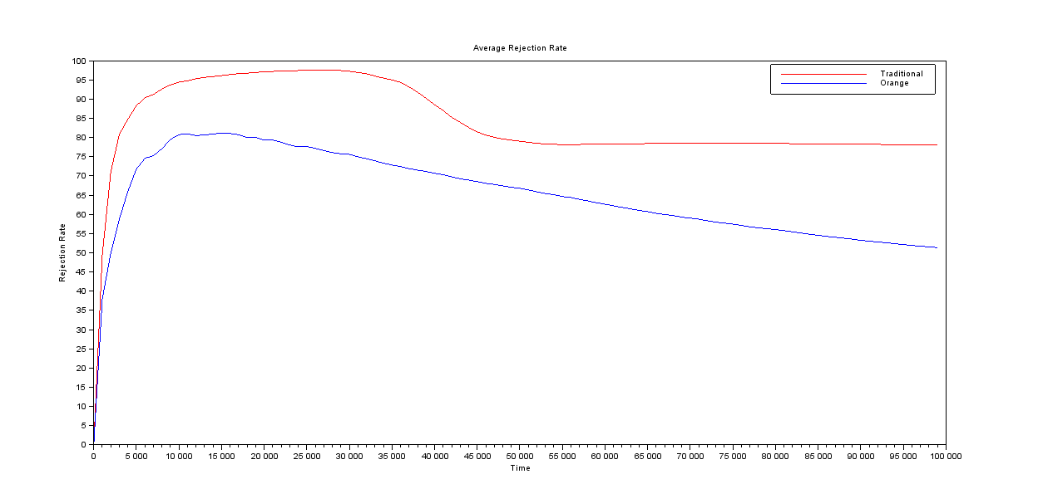
Rejection Rate

Slide 73
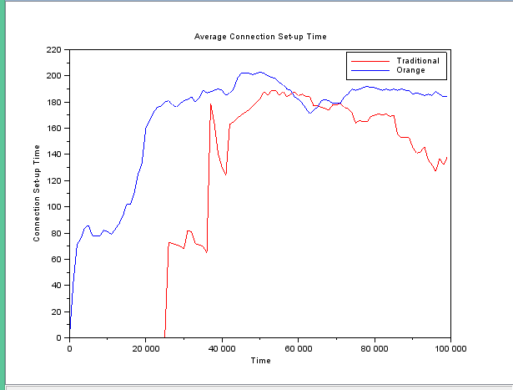
Connection Set-up Time

Slide 74
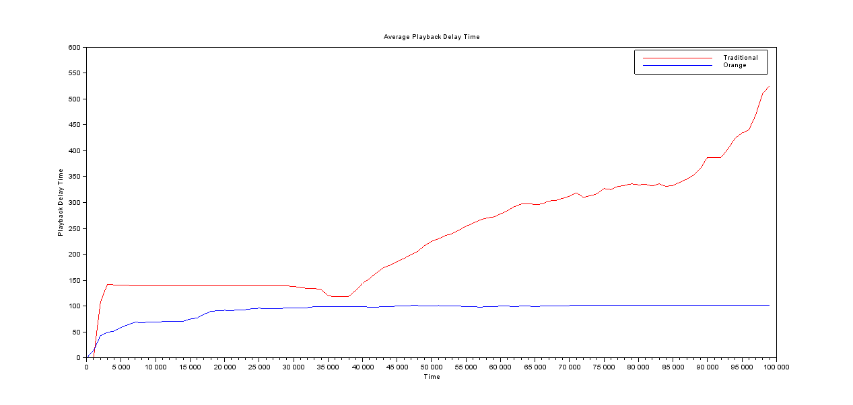
Playback Delay

Slide 75
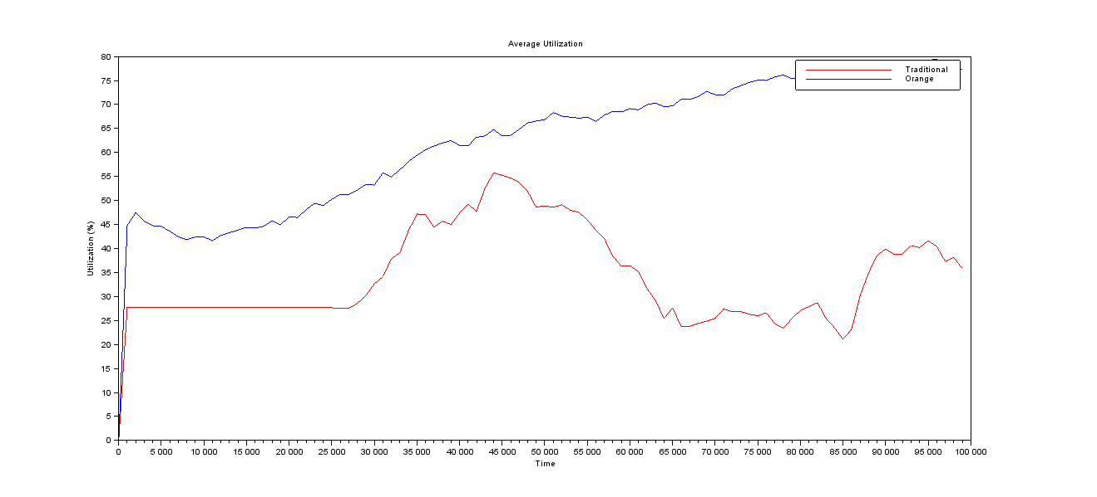
Utilization Rate

Slide 76
Future Work
(For the Second Semester)

Slide 77
Future Work
Integration of AEPS
Modify configuration of simulation
Video Size
Upload and Download Speed
Number of videos and categories
More simulations

Slide 78
References
T. Kim, S. Jeon, and Y. Kim, “A CDN-P2P Hybrid Architecture with Content/Location Awareness for Live Streaming Service Networks,” 2011 IEEE 15th International Symposium on Consumer Electronics, 2011.
T. Hsiao, M. Hsu, and M. Yiao, “Adaptive and Efficient Peer Selection in Peer-to-Peer Streaming Networks,” 2011 IEEE 17th International Conference on Parallel and Distributed Systems, 2011.
D. Xu, S. Kulkarni, C. Rosenberg, and H. Chai, “Analysis of a CDN-P2P hybrid architecture for cost-effective streaming media distribution,” Springer Multimedia Systems, vol. 11, no. 4, pp. 383-399, 2006.

